Slide 1

Reverting the clock
from micro to the muscle

Slide 2


AGENDA
03 | Introduction
04 | Primary goals
06 | Areas of growth
11 | Timeline
14 | Summary

Slide 3

3

Slide 4
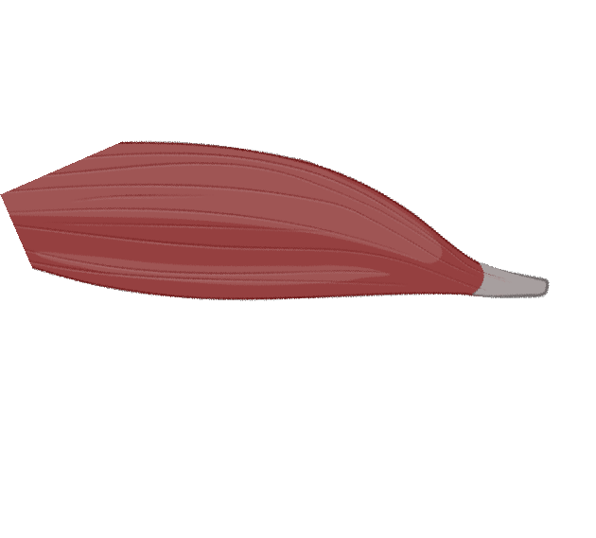


Slide 5




Secret of youth

Slide 6



Slide 7


Slide 8

PRIMARY GOALS
Annual Revenue Growth

Slide 9
QUARTERLY PERFORMANCE

Slide 10
AREAS OF GROWTH
 | B2B | Supply chain | ROI | E-commerce
Q1 | 4.5 | 2.3 | 1.7 | 5.0
Q2 | 3.2 | 5.1 | 4.4 | 3.0
Q3 | 2.1 | 1.7 | 2.5 | 2.8
Q4 | 4.5 | 2.2 | 1.7 | 7.0

Slide 11


“BUSINESS OPPORTUNITIES ARE LIKE BUSES. THERE’S ALWAYS ANOTHER ONE COMING. ”
Richard Branson

Slide 12

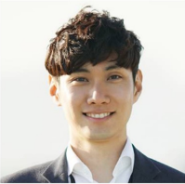


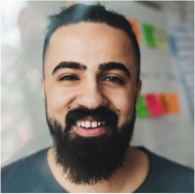
MEET OUR TEAM
TAKUMA HAYASHI​
MIRJAM NILSSON​
FLORA BERGGREN​
RAJESH SANTOSHI​
President
Chief Executive Officer
Chief Operations Officer
VP Marketing

Slide 13
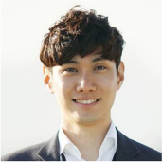







MEET OUR EXTENDED TEAM
TAKUMA HAYASHI​
MIRJAM NILSSON​
FLORA BERGGREN​
RAJESH SANTOSHI​
President
Chief Executive Officer
Chief Operations Officer
VP Marketing
GRAHAM BARNES
ROWAN MURPHY
ELIZABETH MOORE
ROBIN KLINE
VP Product
SEO Strategist
Product Designer
Content Developer

Slide 14
PLAN FOR PRODUCT LAUNCH
Deploy strategic networks with compelling e-business needs
PLANNING
Synergize scalable e-commerce
MARKETING
Disseminate standardized metrics
DESIGN
Coordinate e-business applications
Foster holistically superior methodologies
LAUNCH
STRATEGY

Slide 15

TIMELINE
Sep 20XX
Nov 20XX
Jan 20XX
Mar 20XX
May 20XX
Synergize scalable e-commerce
Disseminate standardized metrics
Coordinate e-business applications
Foster holistically superior methodologies
Deploy strategic networks with compelling e-business needs

Slide 16


AREAS OF FOCUS
B2B MARKET SCENARIOS
Develop winning strategies to keep ahead of the competition
Capitalize on low-hanging fruit to identify a ballpark value
Visualize customer directed convergence
CLOUD-BASED OPPORTUNITIES
Iterative approaches to corporate strategy
Establish a management framework from the inside

Slide 17
HOW WE GET THERE
ROI
NICHE MARKETS
SUPPLY CHAINS
Envision multimedia-based expertise and cross-media growth strategies​
Visualize quality intellectual capital​
Engage worldwide methodologies with web-enabled technologies
Pursue scalable customer service through sustainable strategies​
Engage top-line web services with cutting-edge deliverables
Cultivate one-to-one customer service with robust ideas​
Maximize timely deliverables for real-time schemas

Slide 18


SUMMARY
At Contoso, we believe in giving 110%. By using our next-generation data architecture, we help organizations virtually manage agile workflows. We thrive because of our market knowledge and great team behind our product. As our CEO says, "Efficiencies will come from proactively transforming how we do business."​
​

Slide 19

THANK
Mirjam Nilsson​
mirjam@contoso.com
www.contoso.com
You

